Slide 1
A Hybrid Transformer-Based Sentiment Analysis Model with Emoji-Slang Normalization and Sarcasm Detection
Team Members:
M. Hari Srinivas (24MCB0045)
B. Hemanth Kumar(24MCB0044)
S. Govardhan(24MCB0040)
Faculty Guide:
Dr. R. Manjula(phd) - SCOPE

Slide 2
CONTENTS
INTRODUCTION
PROBLEM STATEMENT
LITERATURE REVIEW
OBJECTIVES
PROPOSED SYSYEM
HARDWARE/SOFTWARE TOOLS
EXPECTED OUTCOME(RESULTS)
CONCLUSION
REFERENCES

Slide 3
Introduction
Earlier, sentiment understanding was mainly achieved through manual approaches like surveys and feedback analysis. However, with the explosion of social media platforms such as Twitter and Facebook, massive volumes of unstructured textual data have made Sentiment Analysis (SA) essential for interpreting opinions and emotions online.
Traditional machine learning models like SVM and Naïve Bayes struggle to handle informal language, emojis, and sarcasm, while deep learning models such as RNN and LSTM improve context handling but still face ambiguity issues.
Transformer-based architectures like BERT, RoBERTa, and DistilBERT have revolutionized NLP by capturing deeper contextual meanings, yet challenges persist in analyzing noisy, slang-filled data.
To overcome these limitations, this research proposes a hybrid transformer-based framework combining DistilBERT, TF-IDF with Logistic Regression, BiLSTM, and RoBERTa-based sarcasm detection, supported by emoji-slang normalization. Using the Sentiment140 dataset, the system enhances accuracy, robustness, and emotional understanding, offering a more comprehensive solution for real-world sentiment analysis.

Slide 4
Problem Statement
Social media text is informal and noisy, filled with slang, emojis, and sarcasm.
Traditional ML models fail to capture deep context and emotional meaning.
Deep learning models improve context but struggle with ambiguity and sarcasm.
Transformer models (BERT, RoBERTa, DistilBERT) perform well but face issues with slang and emoji-based expressions.
There is a need for a hybrid transformer-based framework that combines contextual, statistical, and sarcasm-aware features to improve accuracy and robustness in sentiment analysis.

Slide 5
Literature Review
S.No | Author | Title | Description
1 | S. Gupta, A. Jain, and S. Singh (2021) | Machine Learning Techniques for Twitter Data Using Sentiment Analysis | Focused on early lexicon and rule-based sentiment analysis methods for Twitter data. The study highlighted limitations of dictionary-based techniques when handling informal expressions, emojis, and sarcasm in unstructured social media text.
2 | A. Rahat, M. Hasan, and S. Khan (2020) | Comparison of Naïve Bayes and SVM Algorithm Based on Sentiment Analysis Using Review Dataset | Compared the performance of Naïve Bayes and SVM classifiers using product review datasets. Found that SVM achieves higher precision and robustness but noted that classical lexicon-based methods underperform on unstructured text.

Slide 6
Literature Review
S.No | Author | Title | Description
3 | Yosra Bouassida and Hakim Mezali (2023) | Enhancing Twitter Sentiment Analysis Using Hybrid Transformer and Sequence Models | proposed a hybrid sentiment analysis model integrating Transformer architectures (BERT, RoBERTa, DistilBERT) with sequence models (BiLSTM and CNN) to enhance contextual and semantic understanding on the Sentiment140 dataset. However, the study lacked mechanisms for emoji and slang normalization, sarcasm detection, and explainable ensemble fusion, which limits its performance on informal and irony-heavy Twitter text.
4 | Pushpa Mohan, G. Ranjith Kumar, et al. (2023) | Multimodal Sentimental Classification Using Long-Short Term Memory | Introduced LSTM-based architecture for multimodal data (text, video, and audio). Applied on CMU-MOSI and CMU-MOSEI datasets, achieving 91% binary accuracy. Validated LSTM’s effectiveness in capturing long-term dependencies in sentiment flow.

Slide 7
Literature Review
S.No | Author | Title | Description
5 | H. R. Akhtar and M. Patel (2022) | Deep Learning for Multimodal Sentimental Analysis | Discussed deep learning approaches (CNN, RNN, LSTM) for sentiment analysis across multiple modalities—text, image, and audio. Highlighted that frequency-based models fail to capture deeper contextual understanding in textual sentiment.
6 | Amira Samy Talaat (2023) | Sentiment Analysis Classification System Using Hybrid BERT Models | Proposed hybrid deep learning systems combining BERT with BiLSTM and BiGRU to enhance contextual emotion classification on Twitter data. Demonstrated improved accuracy and generalization compared to standalone Transformer models.

Slide 8
Objectives
To design a hybrid sentiment analysis model that improves the accuracy of emotion detection in social media text.
To combine traditional and deep learning techniques for better handling of context and language variations.
To include sarcasm detection and emoji-slang interpretation for more reliable sentiment classification.
To create a robust and scalable system capable of analyzing real-time social media data effectively.
To provide a foundation for future enhancements such as multilingual and fine-grained emotion analysis.

Slide 9
Proposed System
A hybrid sarcasm-aware sentiment analysis model is proposed for social media text.
Combines DistilBERT, TF-IDF + Logistic Regression, BiLSTM, and RoBERTa-based sarcasm detection.
Includes emoji-slang normalization and weighted ensemble fusion for better accuracy.
Trained on the Sentiment140 dataset with 1.6M tweets.
Achieved 86.58% accuracy, showing improved robustness and context understanding.

Slide 10
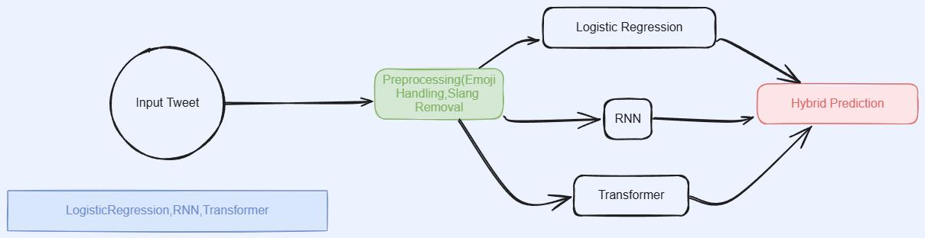
Architecture Diagram

Slide 11
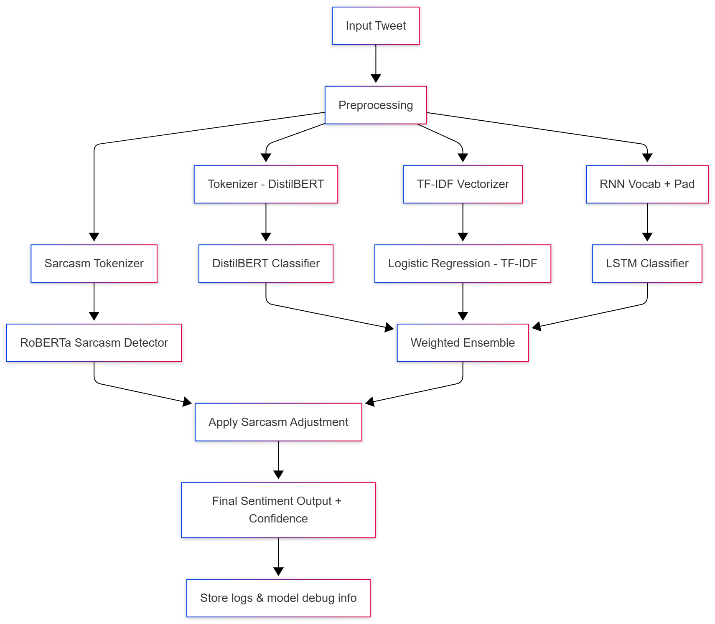

Slide 12


Hardware/Software Description
Programming Language:
Python
Software IDE:
GOOGLE COLAB

Slide 13
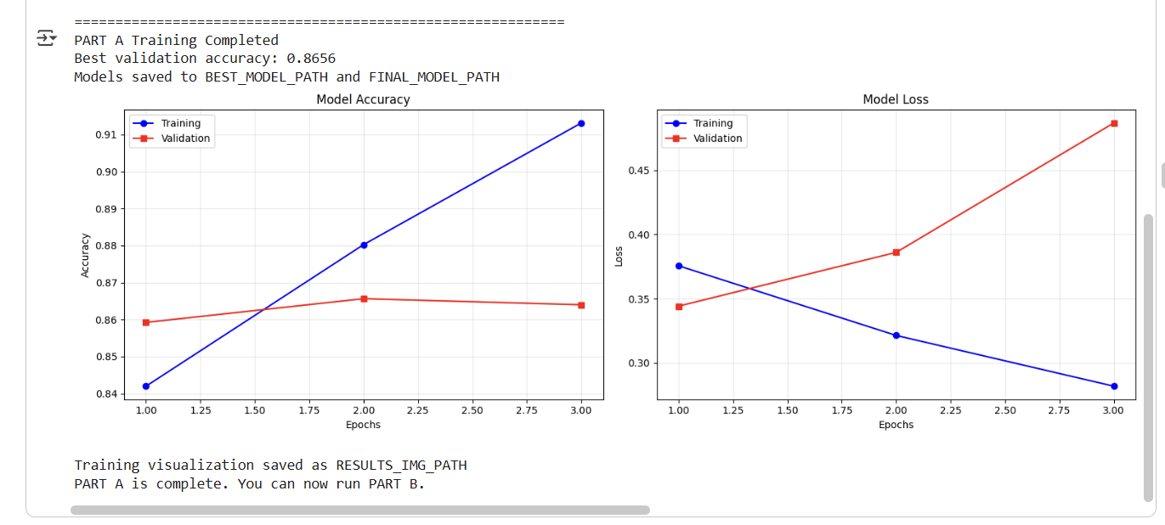
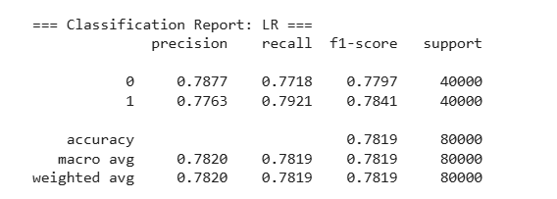
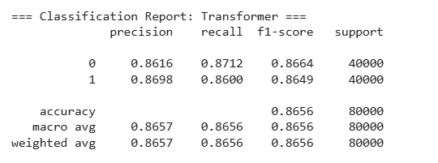
Results

Slide 14
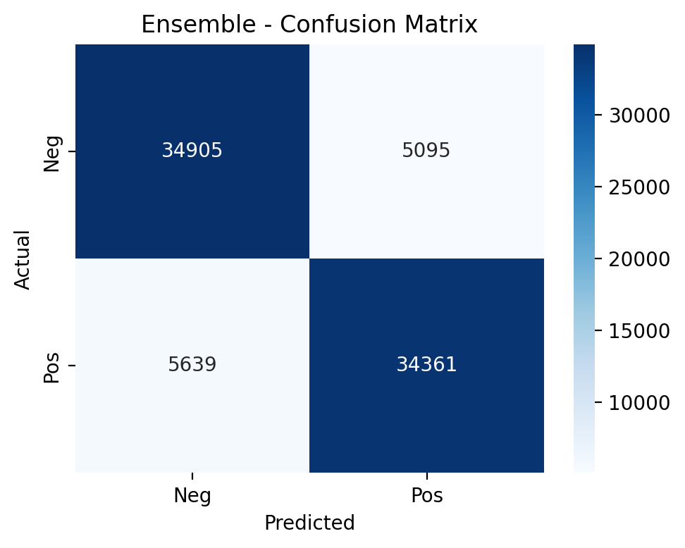
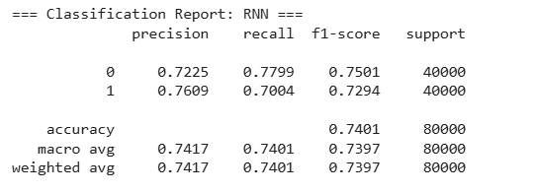
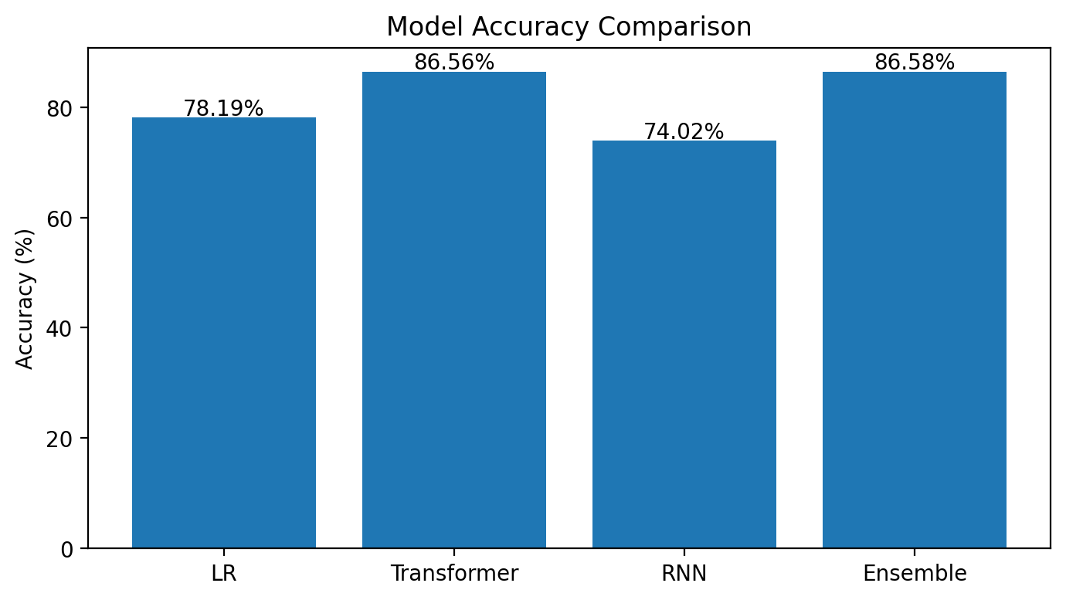
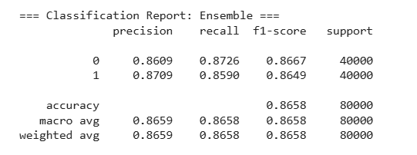

Slide 15
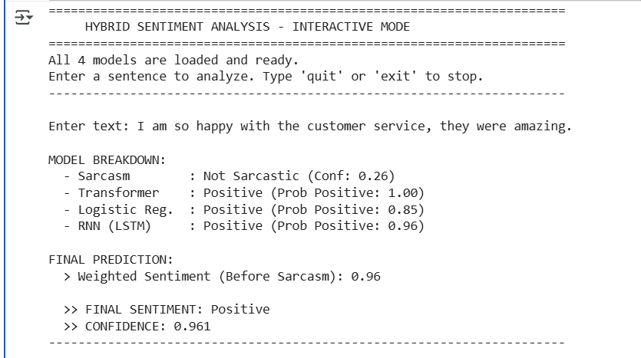
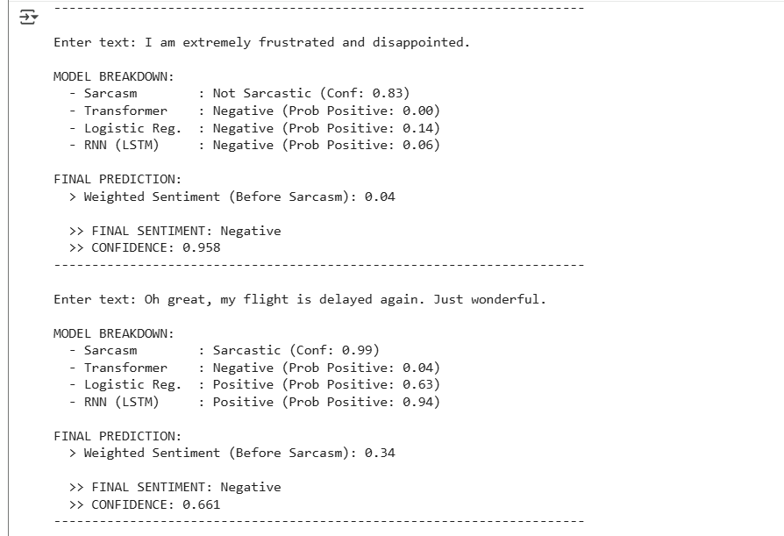
Final Output

Slide 16
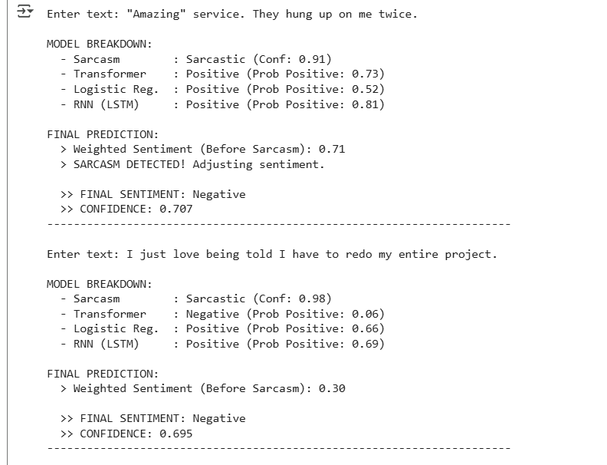
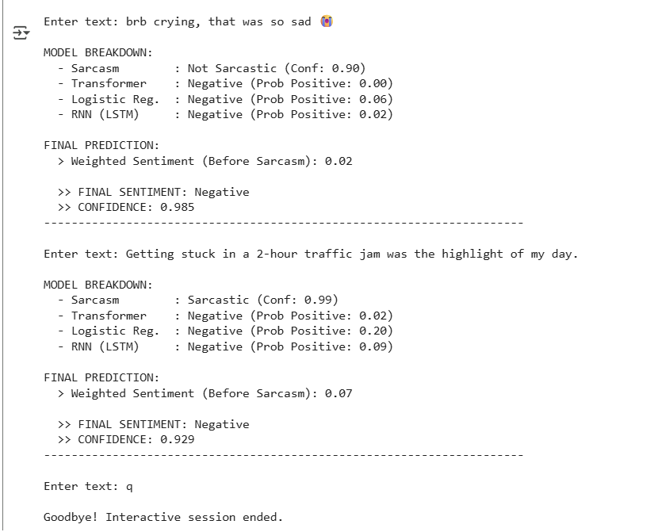

Slide 17
CONCLUSION
The proposed hybrid sentiment analysis system combines DistilBERT, Logistic Regression, and BiLSTM models with a RoBERTa-based sarcasm detector for more accurate sentiment interpretation. The weighted ensemble achieved 86.58% accuracy on Sentiment140, outperforming all individual models while maintaining balanced class performance. The framework effectively handles sarcasm, slang, and emojis, making it suitable for real-time social media analysis. Future work will extend the system to multilingual and fine-grained emotion recognition.

Slide 18
References
[1] S. Baccianella, A. Esuli, and F. Sebastiani, “SentiWordNet 3.0: An Enhanced Lexical Resource for Sentiment Analysis and Opinion Mining,” LREC, 2010.
[2] B. Liu, Sentiment Analysis and Opinion Mining, Morgan & Claypool, 2012.
[3] N. Jain and A. Kumar, “Comparison of Naïve Bayes and SVM Algorithm Based on Sentiment Analysis Using Review Dataset,” International Journal of Computer Science and Information Technologies (IJCSIT), 2020.
[4] Md. Rahman et al., “RoBERTa-BiLSTM: A Context-Aware Hybrid Model for Sentiment Analysis,” arXiv preprint arXiv:2406.00367v2, 2024.
[5] P. Wang et al., “Exploring LSTM Networks for Sentiment Classification,” IEEE Access, 2018.
[6] S. Hochreiter and J. Schmidhuber, “Long Short-Term Memory,” Neural Computation, vol. 9, pp. 1735–1780, 1997.
[7] H. Li and X. Zhang, “Multimodal Sentimental Classification Using Long Short-Term Memory,” IEEE Conference Proceedings, 2021.
[8] Y. Bouassida and H. Mezali, “Enhancing Twitter Sentiment Analysis Using Hybrid Transformer and Sequence Models,” IEEE Conference on Intelligent Systems, 2024.
[9] A. Khan, M. Ali, et al., “Sentiment Analysis of Emoji-Fused Reviews Using Machine Learning and BERT,” Scientific Reports, vol. 15, no. 2, 2025.
[10] A. S. Talaat, “Sentiment Analysis Classification System Using Hybrid BERT-BiLSTM-BiGRU Model,” Journal of Big Data, 2023.

Slide 19
Thank You

